Slide 1
Discrete Mathematics
Introduction
Engr. Ammarah Khalid
Senior Lecturer
Bahria University Karachi Campus
ammarahkhalid.bukc@bahria.edu.pk

Slide 2
Logistics
Three Lectures per week: Each lecture requires reading course book (and an optional reading of reference books)
4 Quizzes (10 Marks)
4 Assignments (20 Marks)
Timely submission 50%
Content 50%
Exams
Mid Term (20 Marks)
Final Term (50 Marks)

Slide 3
Plagiarism
Copying someone else’s work (partial or complete) and submitting it as if it were one’s own
Zero tolerance for plagiarism

Slide 4
Attendance Policy
75% attendance is mandatory.
You have to come in the class within the first 5 minutes in order to get marked as present
Counseling hours: Mentioned on Timetable.

Slide 5
Course Objectives
Think Mathematically
This course will let you think Logically & Mathematically

Slide 6
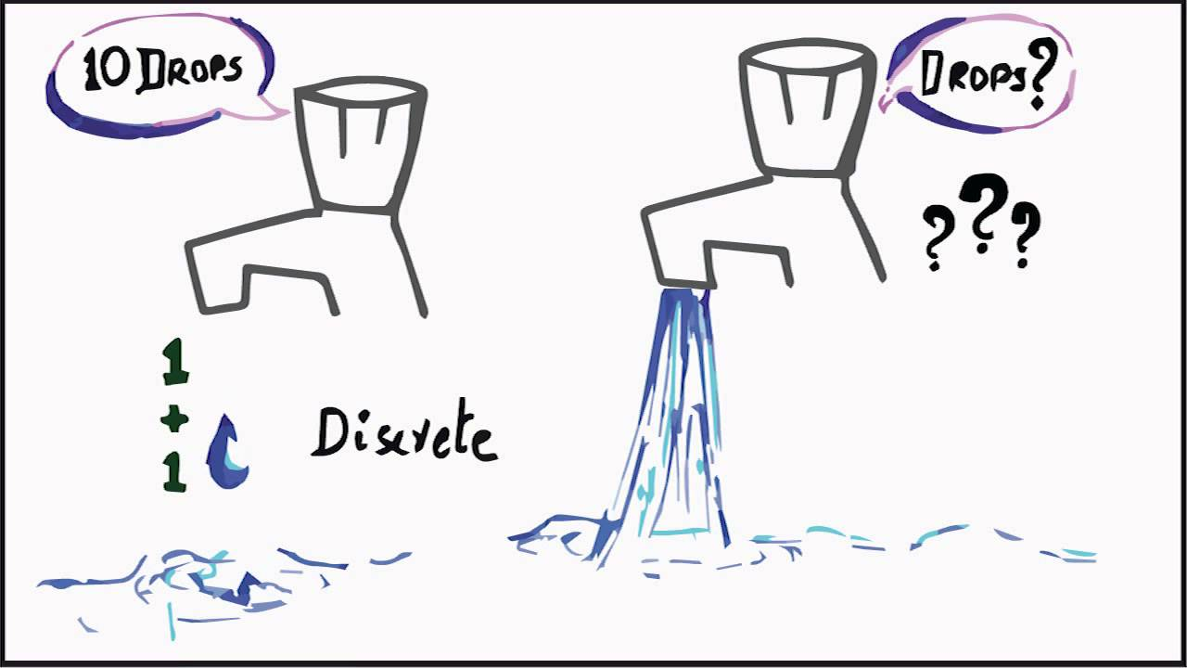
Discrete Structures/Mathematics
Discrete mathematics deals with objects that come in discrete bundles, e.g., 1 or 2 books
Continuous mathematics deals with objects that vary continuously, e.g., 3.42 inches from a wall.
Think of digital watches versus analog watches (ones where the second hand loops around continuously without stopping)

Slide 7
Why Study Discrete Structures/ Mathematics
The mathematics of modern computers science is built entirely on Discrete Structures/ Mathematics.
In every programming class there is always some subset of mathematics involved.

Slide 8
Books
Discrete Mathematics and Its Applications, 7th Ed. by Kenneth H. Rosen
Discrete Mathematics with Application , 4th Ed. by Susanna Epp
Discrete Mathematics, 6th Ed. Richard Johnsonbaugh

